Slide 1
IF3141
SISTEM INFORMASI
Social Impacts of Information System
Semester I 2024/2025
IF3141 | TEKNIK INFORMATIKA ITB

Slide 2
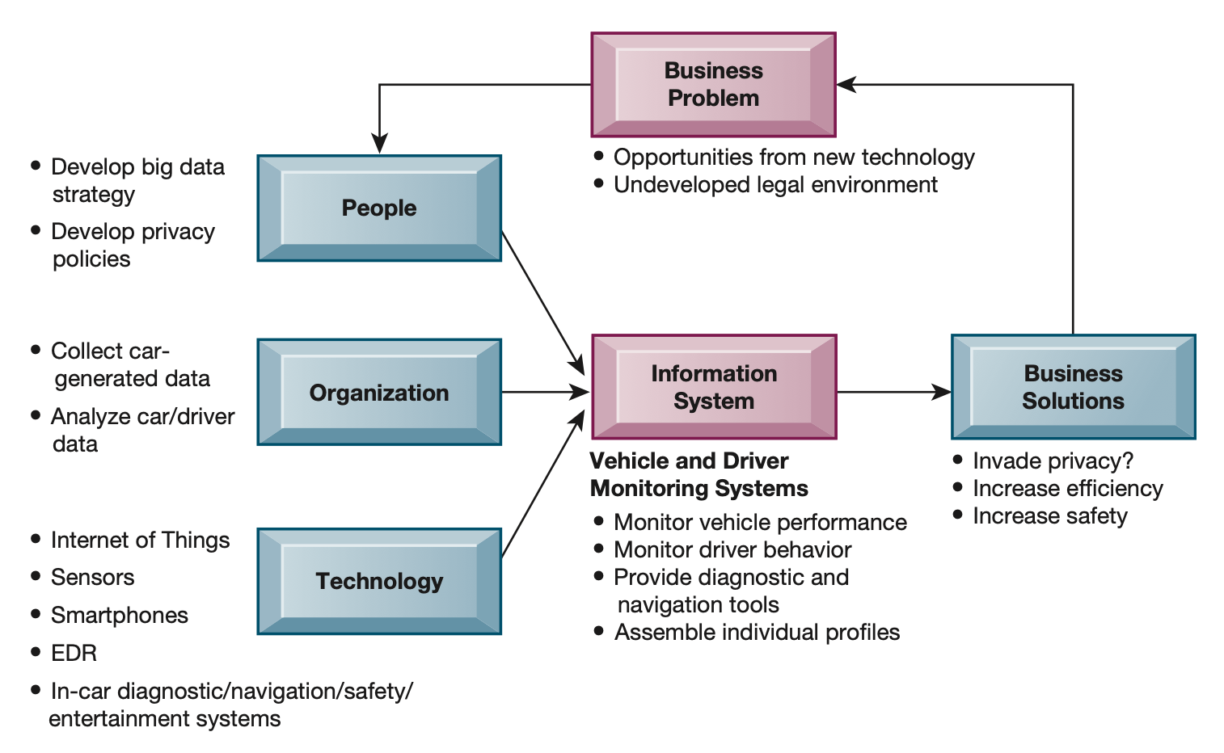
Case: Are Cars becoming Big Brother on Wheels?
Cars have become sophisticated listening posts on wheels
tracking phone calls and texts,
recording what radio stations you listen to,
monitoring the speed at which you drive and your braking actions,
and even telling you when you are breaking the speed limit, often without your knowledge.

Slide 3
IS are around us especially in Organisation
Type of System | Information Inputs | Processing | Information Outputs | Users
ESS | Aggregate data; external; internal | Graphics; simulations; interactive | Projections; responses to queries | Senior managers
DSS | Low-volume data or massive databases optimized for data analysis; analytic models & data analysis tools | Interactive; simulations; analysis | Special reports; decision analysis; responses to queries | Professionals; staff managers
MIS | Summary transaction data; high-volume data; simple models | Routine reports; simple models; low-level analysis | Summary & exeptions reports | Middle managers
KWS | Design specifications; knowledge base | Modeling; simulations | Models; graphics | Professionals; technical staff
Office Systems | Documents; schedules | Document management; scheduling; communication | Documents; schedules; mail | Clerical workers
TPS | Transactions; events | Sorting; listing; merging; updating | Detailed reports; lists; summaries | Operations personel; supervisors

Slide 4
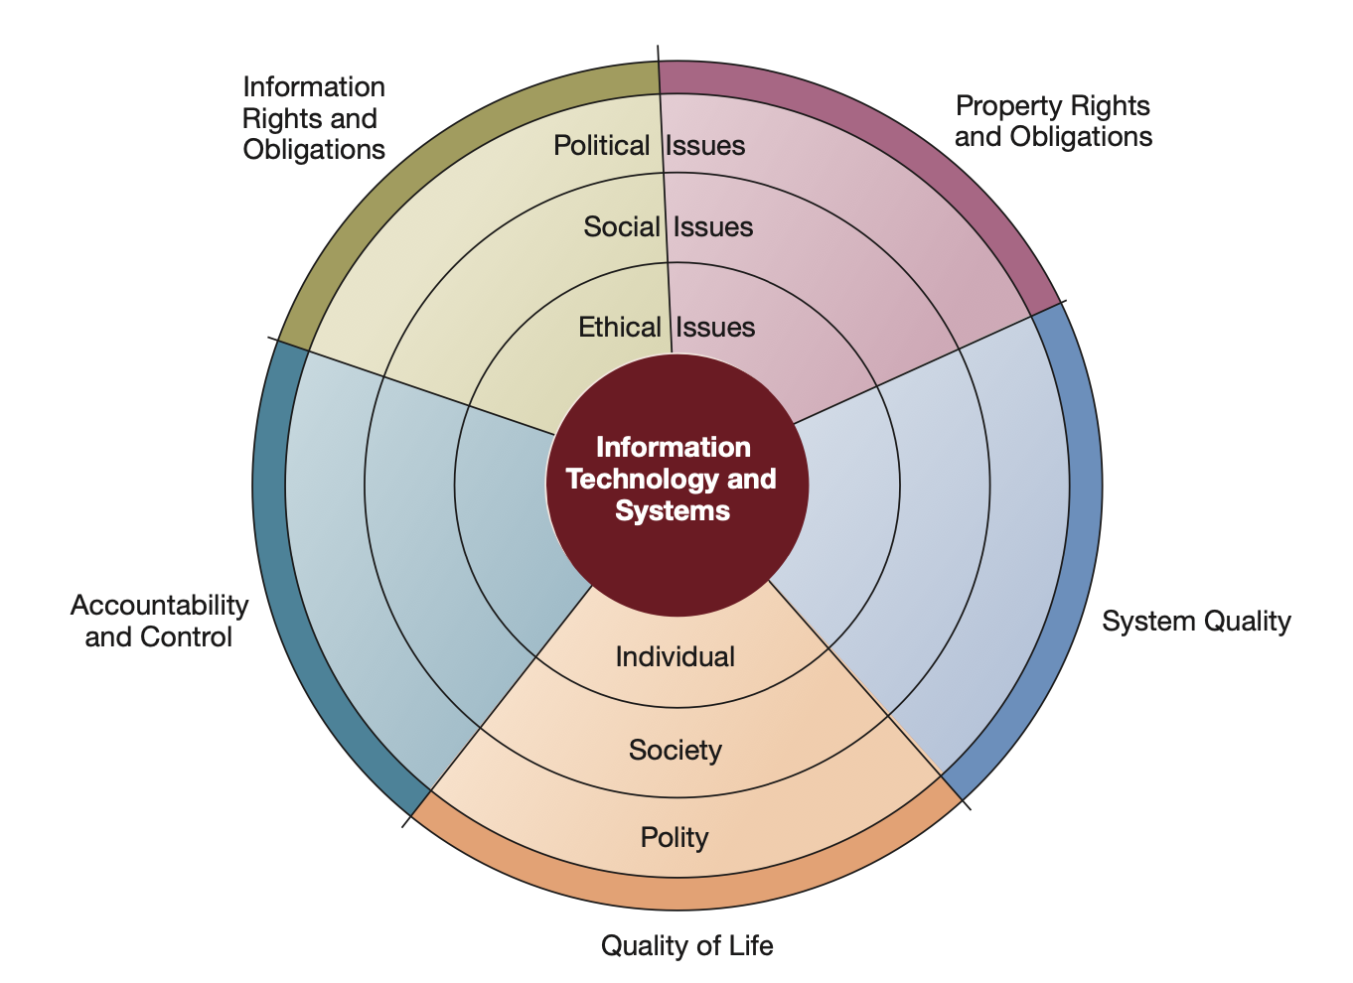
What ethical, social, and political issues are raised by information systems?

Slide 5
Five Moral Dimensions of The Information Age (1)
Information rights and obligations
What information rights do individuals and organizations possess with respect to themselves? What can they protect?
Property rights and obligations
How will traditional intellectual property rights be protected in a digital society in which tracing and accounting for ownership are difficult, and ignoring such property rights is so easy?
Accountability and control
Who can and will be held accountable and liable for the harm done to individual and collective information and property rights?

Slide 6
Five Moral Dimensions of The Information Age (2)
System quality
What standards of data and system quality should we demand to protect individual rights and the safety of society?
Quality of life
What values should be preserved in an information- and -knowledge- based society? Which institutions should we protect from violation? Which cultural values and practices does the new information technology support?

Slide 7
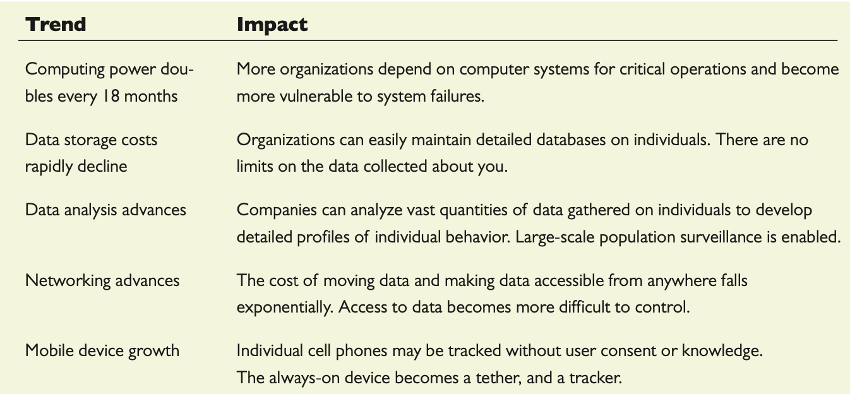
Technology Trends that Raise Ethical Issues

Slide 8
Principles for Conduct to guide Ecthical Decision
Responsibilities
A key element of ethical action
Responsibility means that you accept the potential costs, duties, and obligations for the decisions you make.
Accountability
A feature of systems and social institutions
It means that mechanisms are in place to determine who took action and who is responsible.
Liability
Liability is a feature of political systems in which a body of laws is in place that permits individuals to recover the damages done to them by other actors, systems, or organizations.

Slide 9
Principles for Conduct to guide Ethical Decision
These basic concepts form the underpinning of an ethical analysis of information systems and those who manage them.
First, information technologies are filtered through social institutions, organizations, and individuals. Whatever information system effects exist are products of institutional, organizational, and individual actions and behaviors.
Second, responsibility for the consequences of technology falls on the institutions, organizations, and individual managers who choose to use the technology. Using information technology in a socially responsible manner means that you can and will be held accountable for the consequences of your actions.
Third, in an ethical, political society, individuals and others can recover damages done to them through a set of laws characterized by due process.

Slide 10
Principles for Conduct to guide Ethical Decision
Third, in an ethical, political society, individuals and others can recover damages done to them through a set of laws characterized by due process.
Due process is a related feature of law-governed societies and is a process in which laws are known and understood, and ability exists to appeal to higher authorities to ensure that the laws are applied correctly.

Slide 11
Ethical Analysis
How should you analyze when confronted with a situation that present ethical issues?
Identify and describe the facts clearly
Define the conflict or dilemma and identify the higher-order values involved
Identify the stakeholders
Identify the options that you can reasonably take
Identify the potential consequences of your options

Slide 12
Ethical Principles (1)
What ethical principles should you use to make a decision?
Do unto others as you would have them do unto you (The Golden Rule)
Putting yourself in the place of others, and thinking of yourself as the object of the decision, can help you think about fairness in decision making.
If an action is not right for everyone to take, it is not right for anyone (Immanuel Kant’s categorical imperative)
Ask yourself, “If everyone did this, could the organization, or society, survive?”

Slide 13
Ethical Principles (2)
What ethical principles should you use to make a decision?
If an action cannot be taken repeatedly, it is not right to take at all.
Slippery slope rule: An action may bring about a small change now that is acceptable, but if it is repeated, it would bring unacceptable changes in the long run
Take the action that achieves the higher or greater value (Utilitarian principle).
Prioritize values in a rank order and understand the consequences of various courses of action.

Slide 14
Ethical Principles (3)
What ethical principles should you use to make a decision?
Take the action that produces the least harm or the least potential cost (risk aversion principle)
Avoid actions that have extremely high failure costs; focus on reducing the probability of accidents occurring
Assume that virtually all tangible and intangible objects are owned by someone else unless there is a specific declaration otherwise (Ethical no-free-lunch rule)
If something someone else has created is useful to you, it has value, and you should assume the creator wants compensation for this work.

Slide 15
Professional Code of Conduct
Professisonal codes of conduct are promulgated by associations of professionals
Association of Information Technology Professionals (AITP)
The Association for Computing Machinery (ACM).
Codes of ethics are promises by professions to regulate themselves in the general interest of society.

Slide 16
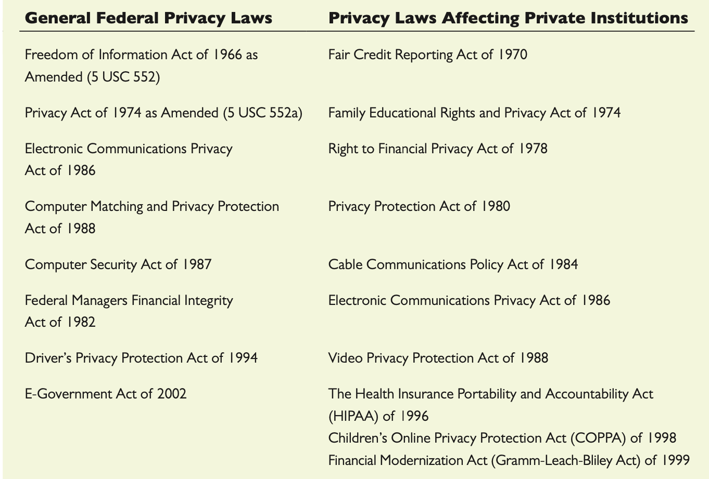
Information Rights: Privacy And Freedom In The Internet Age
Privacy is the claim of individuals to be left alone, free from surveillance or interference from other individuals or organizations, including the state.

Slide 17
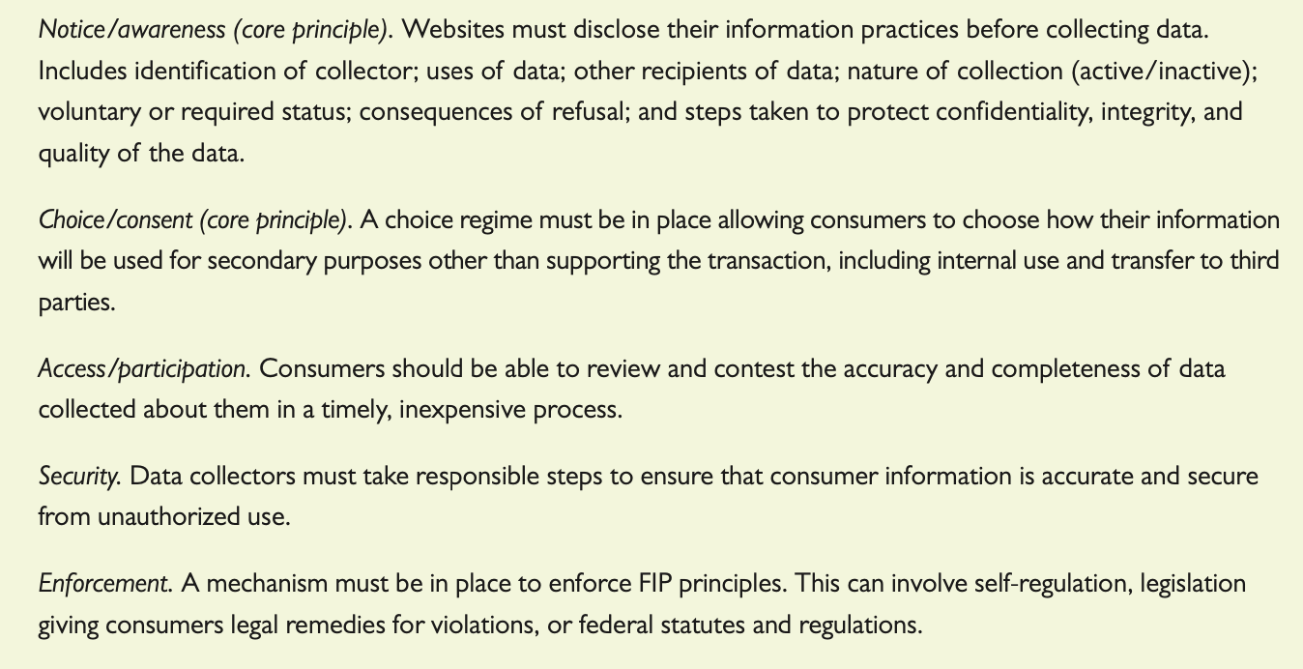
Information Rights: Privacy And Freedom In The Internet Age
Most American and European privacy law is based on a regime called Fair Information Practices (FIP)

Slide 18
Information Rights: Privacy And Freedom In The Internet Age
The European Commission implemented the EU General Data Protection Regulation (GDPR) (2018)
It applies to all firms and organizations that collect, store, or process personal information of EU citizens, and these protections apply worldwide regardless of where the processing takes place
It strengthen the rights of citizens to their own personal information and to strengthen oversight of firms to ensure they implement these individual rights.
It protects a wide variety of PII: basic identity information (i.e name, address, ID numbers); web data (i.e. location, IP address, cookie data, RFID tags); health and genetic data; mobile phone number; driver’s license and passport number; biometric and facial data; racial and ethnic data; political opinions; and sexual orientation.

Slide 19
Property Rights: Intellectual Property
Intellectual property is defined as tangible and intangible products of the mind created by individuals or corporations.
Copyright
A statutory grant that protects creators of intellectual property from having their work copied by others for any purpose during the life of the author plus an additional certain years after the author’s death
The drawback to copyright protection is that the underlying ideas behind a work are not protected, only their manifestation in a work. A competitor can use your software, understand how it works, and build new software that follows the same concepts without infringing on a copyright.

Slide 20
Property Rights: Intellectual Property
Patents
An exclusive monopoly on the ideas behind an invention for certain years. It is to ensure that inventors of new machines, devices, or methods receive the full financial and other rewards of their labour and yet make widespread use of the invention possible by providing detailed diagrams for those wishing to use the idea under license from the patent’s owner, based on originality, novelty, and invention
The strength of patent protection is that it grants a monopoly on the underlying concepts and ideas of software. The difficulty is passing stringent criteria of nonobviousness (the work must reflect some special understanding and contribution), originality, and novelty as well as years of waiting to receive protection.

Slide 21
Property Rights: Intellectual Property
Trademarks
The marks, symbols, and images used to distinguish products in the marketplace.
Trade Secrets
Any intellectual work product—a formula, device, pattern, or compilation of data— used for a business purpose can be classified as a trade secret, provided it is not based on information in the public domain
Trade secret laws grant a monopoly on the ideas behind a work product, but it can be a very tenuous monopoly.

Slide 22
Property Rights: Intellectual Property
Challenges to Intellectual Property Rights
Digital media -> Ease of replication
The proliferation of digital networks, including the internet

Slide 23
Accountability and Control: Liability Problems
Who is liable for any economic or personal harm caused to individuals or businesses whose personal and business data is stolen from firms with whom they interact, often on a daily basis?
2018 Under Armour disclosed that hackers had breached its fitness app (MyFitnessPal) and had stolen data from over 150 million user accounts. The data included email addresses, passwords, and usernames, along with other information not disclosed. The firm’s stock took a hit of 2% following the announcement and likely caused MyFitnessPal users to lose confidence in the app.

Slide 24
System Quality: Data Quality and System Errors
What is an acceptable, technologically feasible level of system quality? When to stop testing is ok?
Google Cloud experienced an outage that took down entire platforms like Snapchat, Spotify, Pokemon GO.
Amazon Web Services (AWS) experienced an outage that took down Amazon’s own Alexa, and several enterprise services such as Atlassian, Slack, and Twilio.
Microsoft’s Azure service had an outage that effected its storage and networking service in Northern Europe.
The gray area is that some system errors are foreseeable and correctable only at great expense, expense so great that pursuing this level of perfection is not feasible economically—no one could afford the product.

Slide 25
Quality of Life: Equity, Access, and Boundaries
Computers and information technologies potentially can destroy valuable elements of our culture and society even while they bring us benefits.
If there is a balance of good and bad consequences of using information systems, whom do we hold responsible for the bad consequences

Slide 26
Quality of Life: Equity, Access, and Boundaries
Big Tech: Concentrating Economic and Political Power
Amazon: Half of retail e-commerce
Google: 87 percent of online search
Netflix: 75 % of video streamers
Microsoft: 90% of PCs using WIndows
. . .
Critics point out that consumer welfare is harmed in other ways than price, namely, by preventing new, innovative companies from market access, or surviving long enough to prosper as independent firms.

Slide 27
Quality of Life: Equity, Access, and Boundaries
Rapidity of Change: Reduced Response Time to Competition
Information systems have helped to create much more efficient national and international markets.
Today’s rapid-moving global marketplace has reduced the normal social buffers that permitted businesses many years to adjust to competition.
Time-based competition has an ugly side; the business you work for may not have enough time to respond to global competitors and may be wiped out in a year along with your job.
We stand the risk of developing a just-in-time society with just-in-time jobs and just-in-time workplaces, families, and vacations. One impact of Uber and on-demand services firms is to create just-in-time jobs with no benefits/insurance for employees.

Slide 28
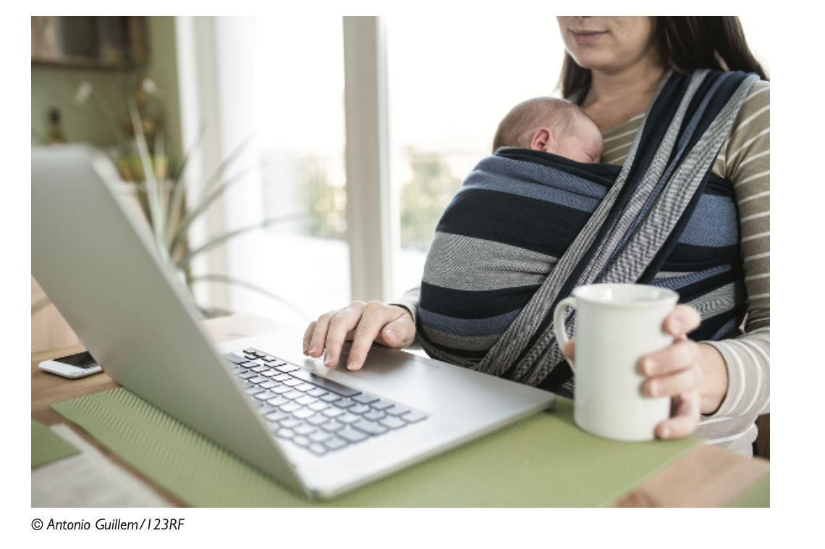
Quality of Life: Equity, Access, and Boundaries
Maintaining Boundaries: Family, Work, and Leisure
The traditional boundaries that separate work from family and just plain leisure have been weakened.

Slide 29
Quality of Life: Equity, Access, and Boundaries
Dependence and Vulnerability
Today, our businesses, governments, schools, and private associations are incredibly dependent on information systems
Therefore, highly vulnerable if these systems fail.
Think of what would happen if the nation’s electric power grid shut down, with no backup structure to make up for the loss of the system?

Slide 30
Quality of Life: Equity, Access, and Boundaries
Computer Crime and Abuse
Computer Crime
The commission of illegal acts by using a computer or against a computer system.
Malware, phishing, network interruption, spyware, and denial of service attacks.
Computer Abuse
The commission of acts involving a computer that may not be illegal but are considered unethical
Spamming

Slide 31
Quality of Life: Equity, Access, and Boundaries
Employment: Trickle-Down Technology and Reengineering Job Loss
Redesigning business processes has caused millions of mid-level factory managers and clerical workers to lose their jobs.
But new technologies also created as many or more new jobs than they destroyed

Slide 32
Quality of Life: Equity, Access, and Boundaries
Equity and Access: Increasing Racial and Social Class Cleavages
Does everyone have an equal opportunity to participate in the digital age?
Digital divide

Slide 33
Reference
Essentials of Management Information Systems, 14Ed Kenneth C. Laudon , Jane P. Laudon 2021, Pearson

